Slide 1
AI in Education
Our new frontier

Slide 2
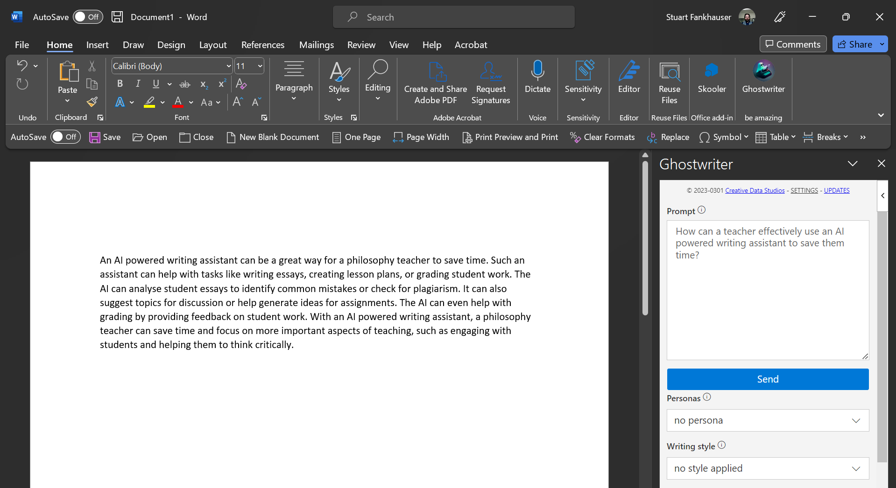

Slide 3
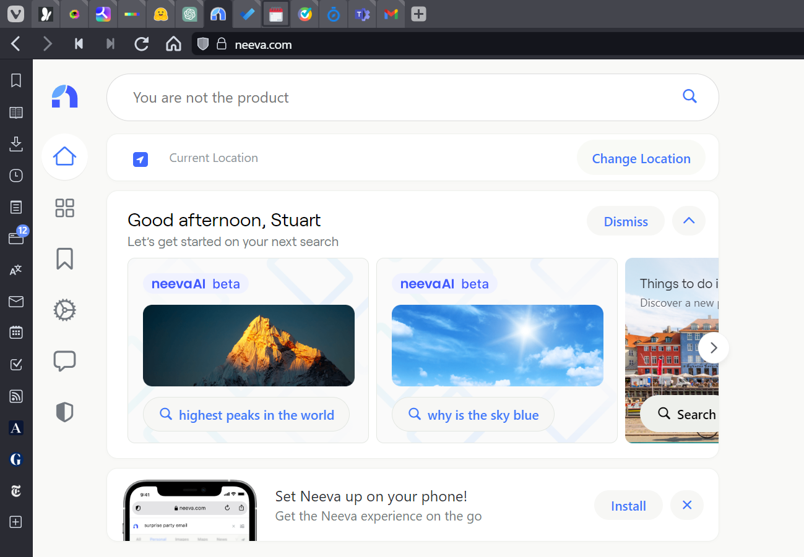

Slide 4
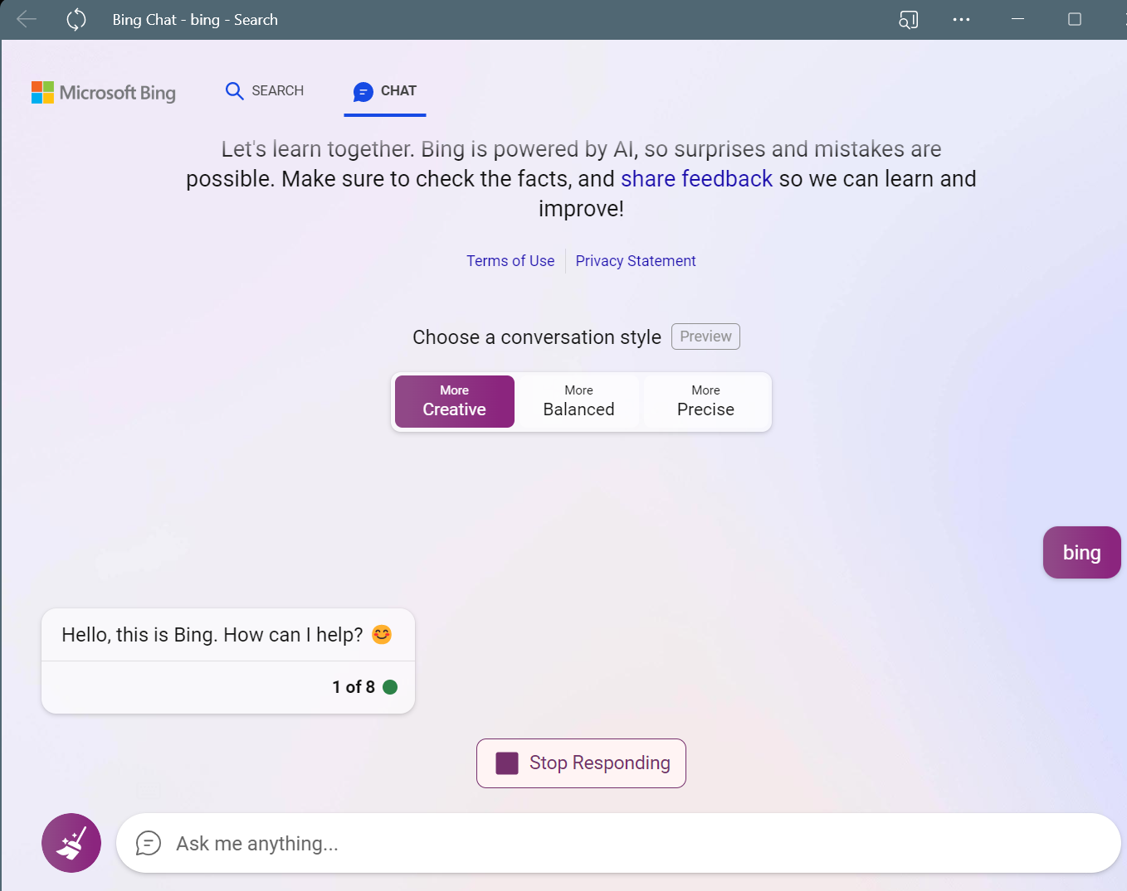

Slide 5
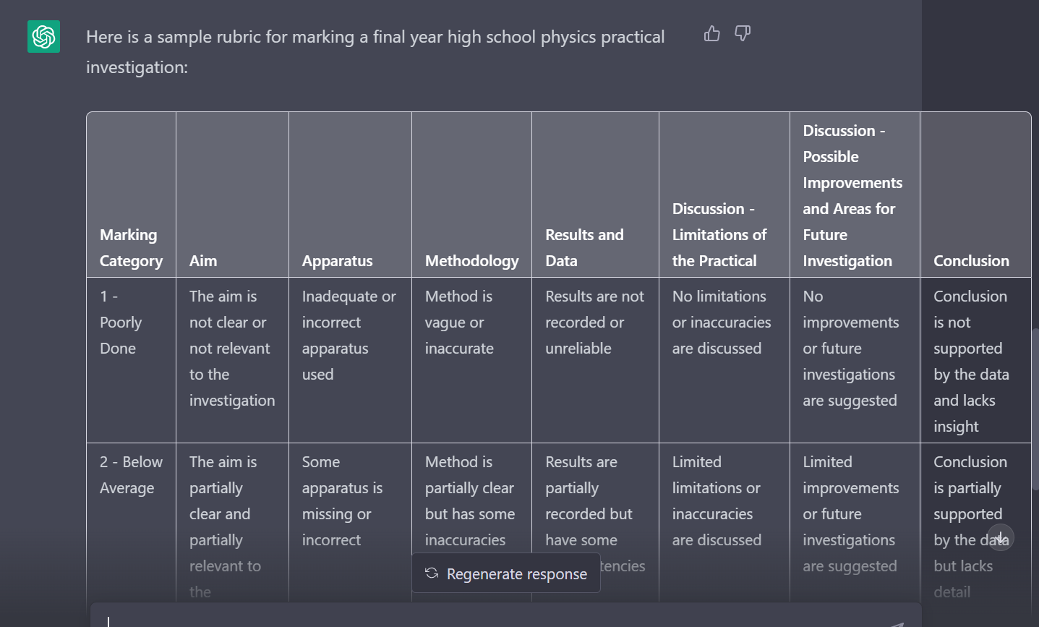

Slide 6
Analysing a Test Post-Mortem

Slide 7
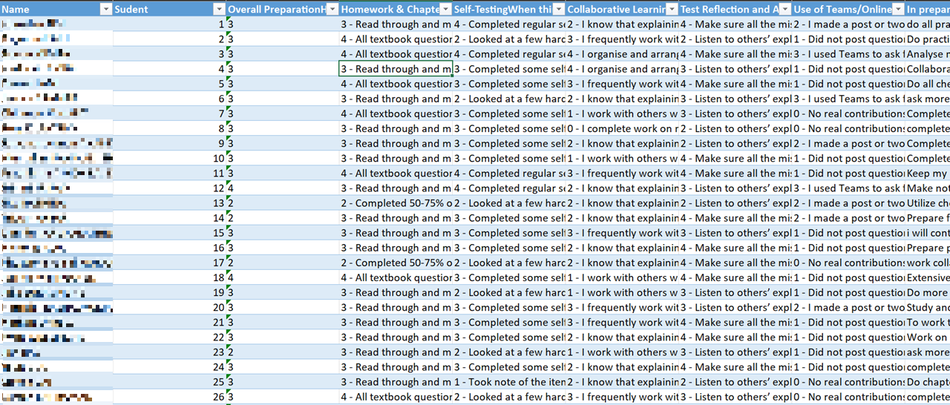
Analysing a Test Post-Mortem

Slide 9
Student | Positive Reinforcement | Areas of Improvement
1 | You made a significant effort to overcome your areas of weakness before the test. You also did regular self-testing to identify your strengths and weaknesses. | Do all practice SACs and checkpoints and complete more practice questions to be confident.
2 | You made extensive use of CheckPoints. | Seek more resources and use them effectively. Collaborate more with peers and actively participate in discussions.
3 | You made a significant effort to overcome your areas of weakness before the test. You completed regular self-testing to identify your strengths and weaknesses. You are active in collaborating with others for the purpose of study. | Keep reflecting on your performance and analyse your mistakes. Do more extensive reflection.
4 | You are active in collaborating with others for the purpose of study. | Collaborate more effectively with your peers and attempt difficult questions from past SACs or checkpoints. Self-assess to understand and rectify limitations in your knowledge.
5 | You made extensive use of CheckPoints. | Collaborate more with others and complete more practice tests, review notes, and complete chapter questions. Create notes on how to tackle specific types of questions/scenarios.
6 | You actively look for opportunities to work with others outside of class. | Prepare well ahead of time and do more checkpoints earlier. Ask more questions and prepare earlier.
7 | You made extensive use of CheckPoints. | Seek additional physics resources and ask questions when unsure about the content. Complete the checkpoint questions at a steady pace as you learn the coursework.
8 | You completed some self-testing to identify areas of strengths and weaknesses. | Make more notes and complete all checkpoints questions.
9 | You actively look for opportunities to work with others outside of class. | Create a more extensive reference sheet as preparation. Complete all checkpoint questions.
10 | You made a significant effort to understand your mistakes. | Collaborate more effectively with others and create a comprehensive reference sheet that includes the steps to answering questions. Start checkpoints earlier and review mistakes made in questions before the SAC.
11 | You made a significant effort to overcome your areas of weakness before the test. You made extensive use of CheckPoints. You are active in collaborating with others for the purpose of study. | Keep your mistakes book updated and seek help from your peers and teachers. Do more practice SAC questions under timed conditions and practice getting used to using your calculator under fast conditions.
12 | You made a significant effort to overcome your areas of weakness before the test. You actively look for opportunities to work with others outside of class. | Make notes and refer to them often to retain much of your knowledge. Do more practice questions and revision materials.
13 | You actively look for opportunities to work with others outside of class. | Utilize checkpoints as a valuable tool to assist with harder questions. Make a time plan to spread your workload over a longer period of time.
14 | You made a significant effort to understand your mistakes. | Prepare for specific types of questions and ask friends and teachers whenever you find something challenging. Prepare for any twists or modifications SACs might put on specific questions. Prepare for SACs at least 2 weeks prior to it.

Slide 10
Proactively Laying the Foundations
AI is coming at us very quickly – much faster than traditional curriculum sources can adapt
Our students are using AI to assist them with their work already
Our students need counsel and direction regarding the ethical and social implications of utilizing AI, both in their education and in their future careers and personal lives.
It may possibly become one of the most significant elements of the digital divide

Slide 11
Using AI in the Classroom
Intelligent.com’s recent survey of college students, released barely two months after the launch of ChatGPT. Fully 30 percent of college students said they were already turning in some ChatGPT-penned assignments; one in thirty said ChatGPT was already doing all their written work. These are the earliest of adopters—it’s a safe bet their ranks will grow dramatically before long. Will ChatGPT Be A Blow To Learning, Or A Boon? We'll Decide. (forbes.com)
What are our Learning Objectives around AI?
What knowledge about AI do we want the students to acquire?
How can students develop key skills around AI that will benefit their learning in the long-term?
How might AI effect the development of a young person’s digital citizenship?

Slide 12
What might ethical AI student use look like?
Writing Assistance: AI-powered writing assistants can help students generate ideas and improve the quality of their writing. Students can use such tools to refine their writing skills and produce more polished work.
Research Assistance: AI-powered search engines can help students find relevant and credible sources for their research. Students can use these tools to save time and improve the quality of their work.
Writing Feedback: AI-powered writing assistants can provide feedback on writing assignments, making suggestions for improvements and help students to produce more polished and refined work.

Slide 13
What might ethical AI student use look like?
Test Preparation: AI-powered test preparation tools can help students prepare for exams by identifying areas where they need to focus their study efforts and providing practice questions and exercises.
Completing Data Analysis: AI-powered data analysis tools can help students analyze complex data sets and identify patterns and trends. This can help students develop their analytical skills.
Automated Summarization: AI-powered summarization tools can help students quickly and accurately summarize long texts and articles. This can help students better understand complex ideas and identify key themes and arguments.

Slide 14
Teaching Objectives
It’s about the Joy of Learning⁽™⁾
Learning needs be even less about achieving an arbitrary benchmark, and more about personal development
Critical Thinking and Problem Solving
Students will need to gain an even broader and deeper understanding of what constitutes quality “information” (credible sources, AI training data, etc.)
Understanding the benefits and limitations of AI
Students should be able to identify the potential benefits and limitations of using AI in the learning process, such as personalized learning experiences, increased efficiency, and the need for human oversight and decision-making.

Slide 15
Teaching Objectives
Understanding the ethical implications of AI and their data
Students will need to be able to identify ethical concerns related to the use of AI during the learning process
privacy and security issues
algorithmic bias
potential misuse of data
Applying AI to real-world situations
Students should be able to apply their understanding of AI to real-world situations, such as analyzing data sets, developing predictive models, or using virtual assistants

Slide 16
What do we want our students to know about AI?
When you use it, use it well
It is ALL in the prompt
How to design prompts effectively
How to design templates for effective prompts
Examples of well written prompts
There are differences between the AI models
How can you tell the difference between a useful AI and a less effective AI?
Who makes the model? What are their motivations? Who are their backers?
This is a rapidly evolving landscape

Slide 17
How can students develop key AI skills?
Active Engagement with AI
Students will need to actively engage with the AI LLMs to improve their skills in using the models. This requires the ability to ask questions, get feedback, and adjust their learning strategies based on their progress.
Opportunities for Reflection
Students will need to reflect on their learning experiences with AI LLMs and be able to identify when and how interactions have gone ‘right’; or ‘wrong’,
They need to see it used effectively across disciplines
Students should be able to ask questions freely about the use of AI and how it might be used to assist their undertaking of different tasks, to assist them in learning material across different topics and help them prepare for assessments.

Slide 18
How might AI effect the development of a young person’s digital citizenship?
Dependence on Technology?
There is a risk that our young people may become too reliant on AI powered tools, losing some elements of their critical thinking and problem-solving capacity. There is also an opportunity to use the emergence of AI tools as a teaching opportunity.
Cultural Exposure?
AI can be both a tool for enhancing and limiting students’ cultural exposure. Will our young people become more susceptible to biases or will AI broaden their perspectives?
A further decrease in human interaction?
AI LLMs can provide learning experiences that simulate human interaction, but there is a risk that students may not receive the full benefits of human interaction in the learning process. They may not have the opportunity to reflect on real-world situations or engage in authentic conversations.

Slide 19
Why Addressing AI is a Professional Imperative for Educators
We are not just faculty members and teachers of a discipline
This has the capacity to affect wellbeing
There is now no avoiding AI

Slide 20
Faculty Based Responses to AI
How is AI likely to affect your teaching with regard to:
Assessment Design
Setting up Revision Material
Developing research tasks
Developing writing tasks
Classroom dynamics
Student discussion and questioning
Student help seeking
Student note-taking
Assessing student wellbeing

Slide 21
Student Based Responses to AI
What might students think when it comes to the availability of AI LLMs and our teaching?
Undertaking Assessments
Preparing for Assessments
Completing Research tasks
Completing Writing tasks
Participating in classroom discussion and questioning
Help seeking
Note-taking
Wellbeing

Slide 22
Jachelt

